Slide 1
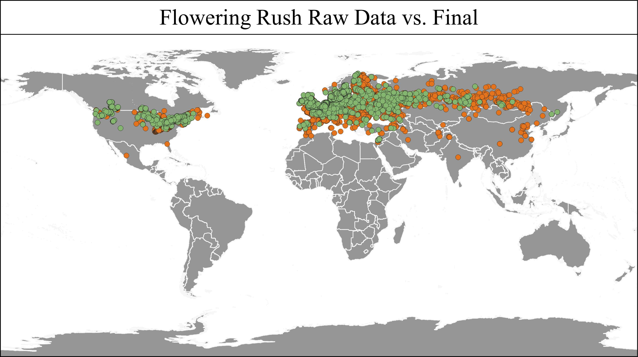
Cleaning in QGIS

Slide 2
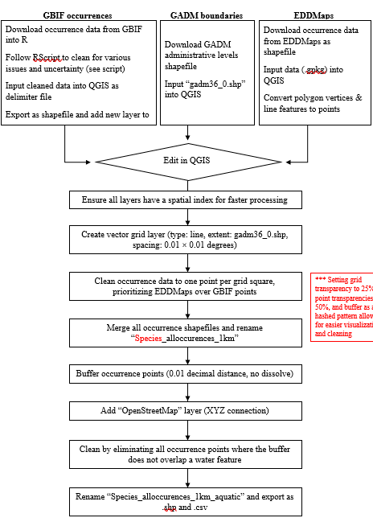
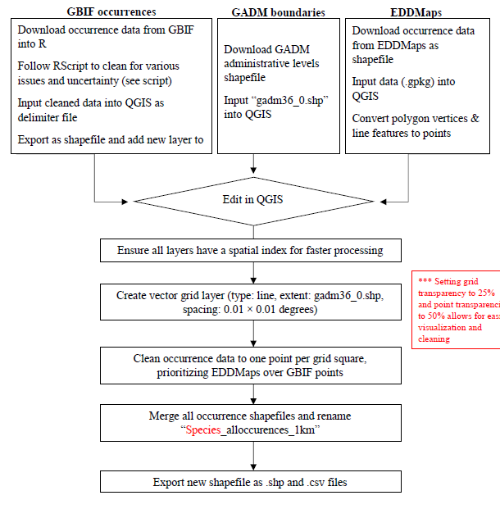
Aquatic
Terrestrial

Slide 3
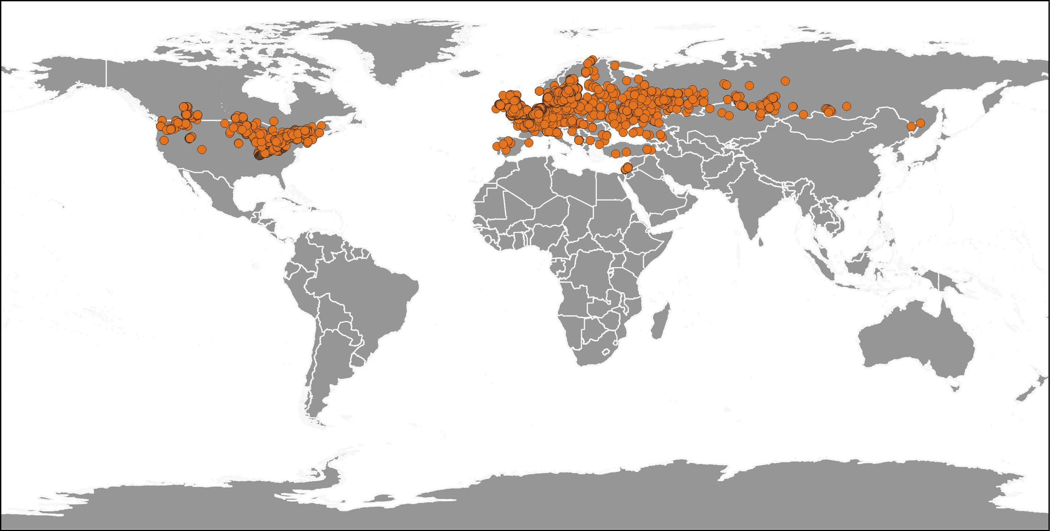
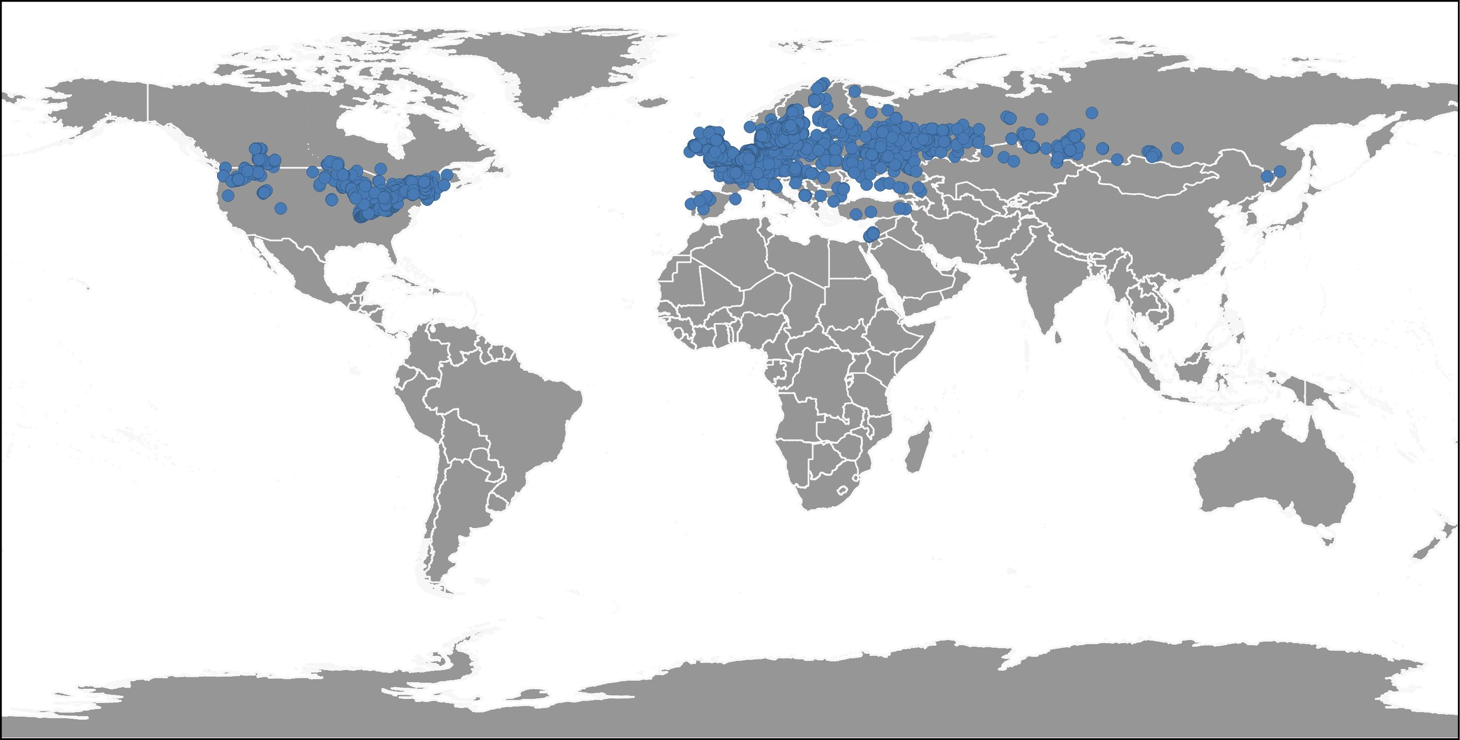
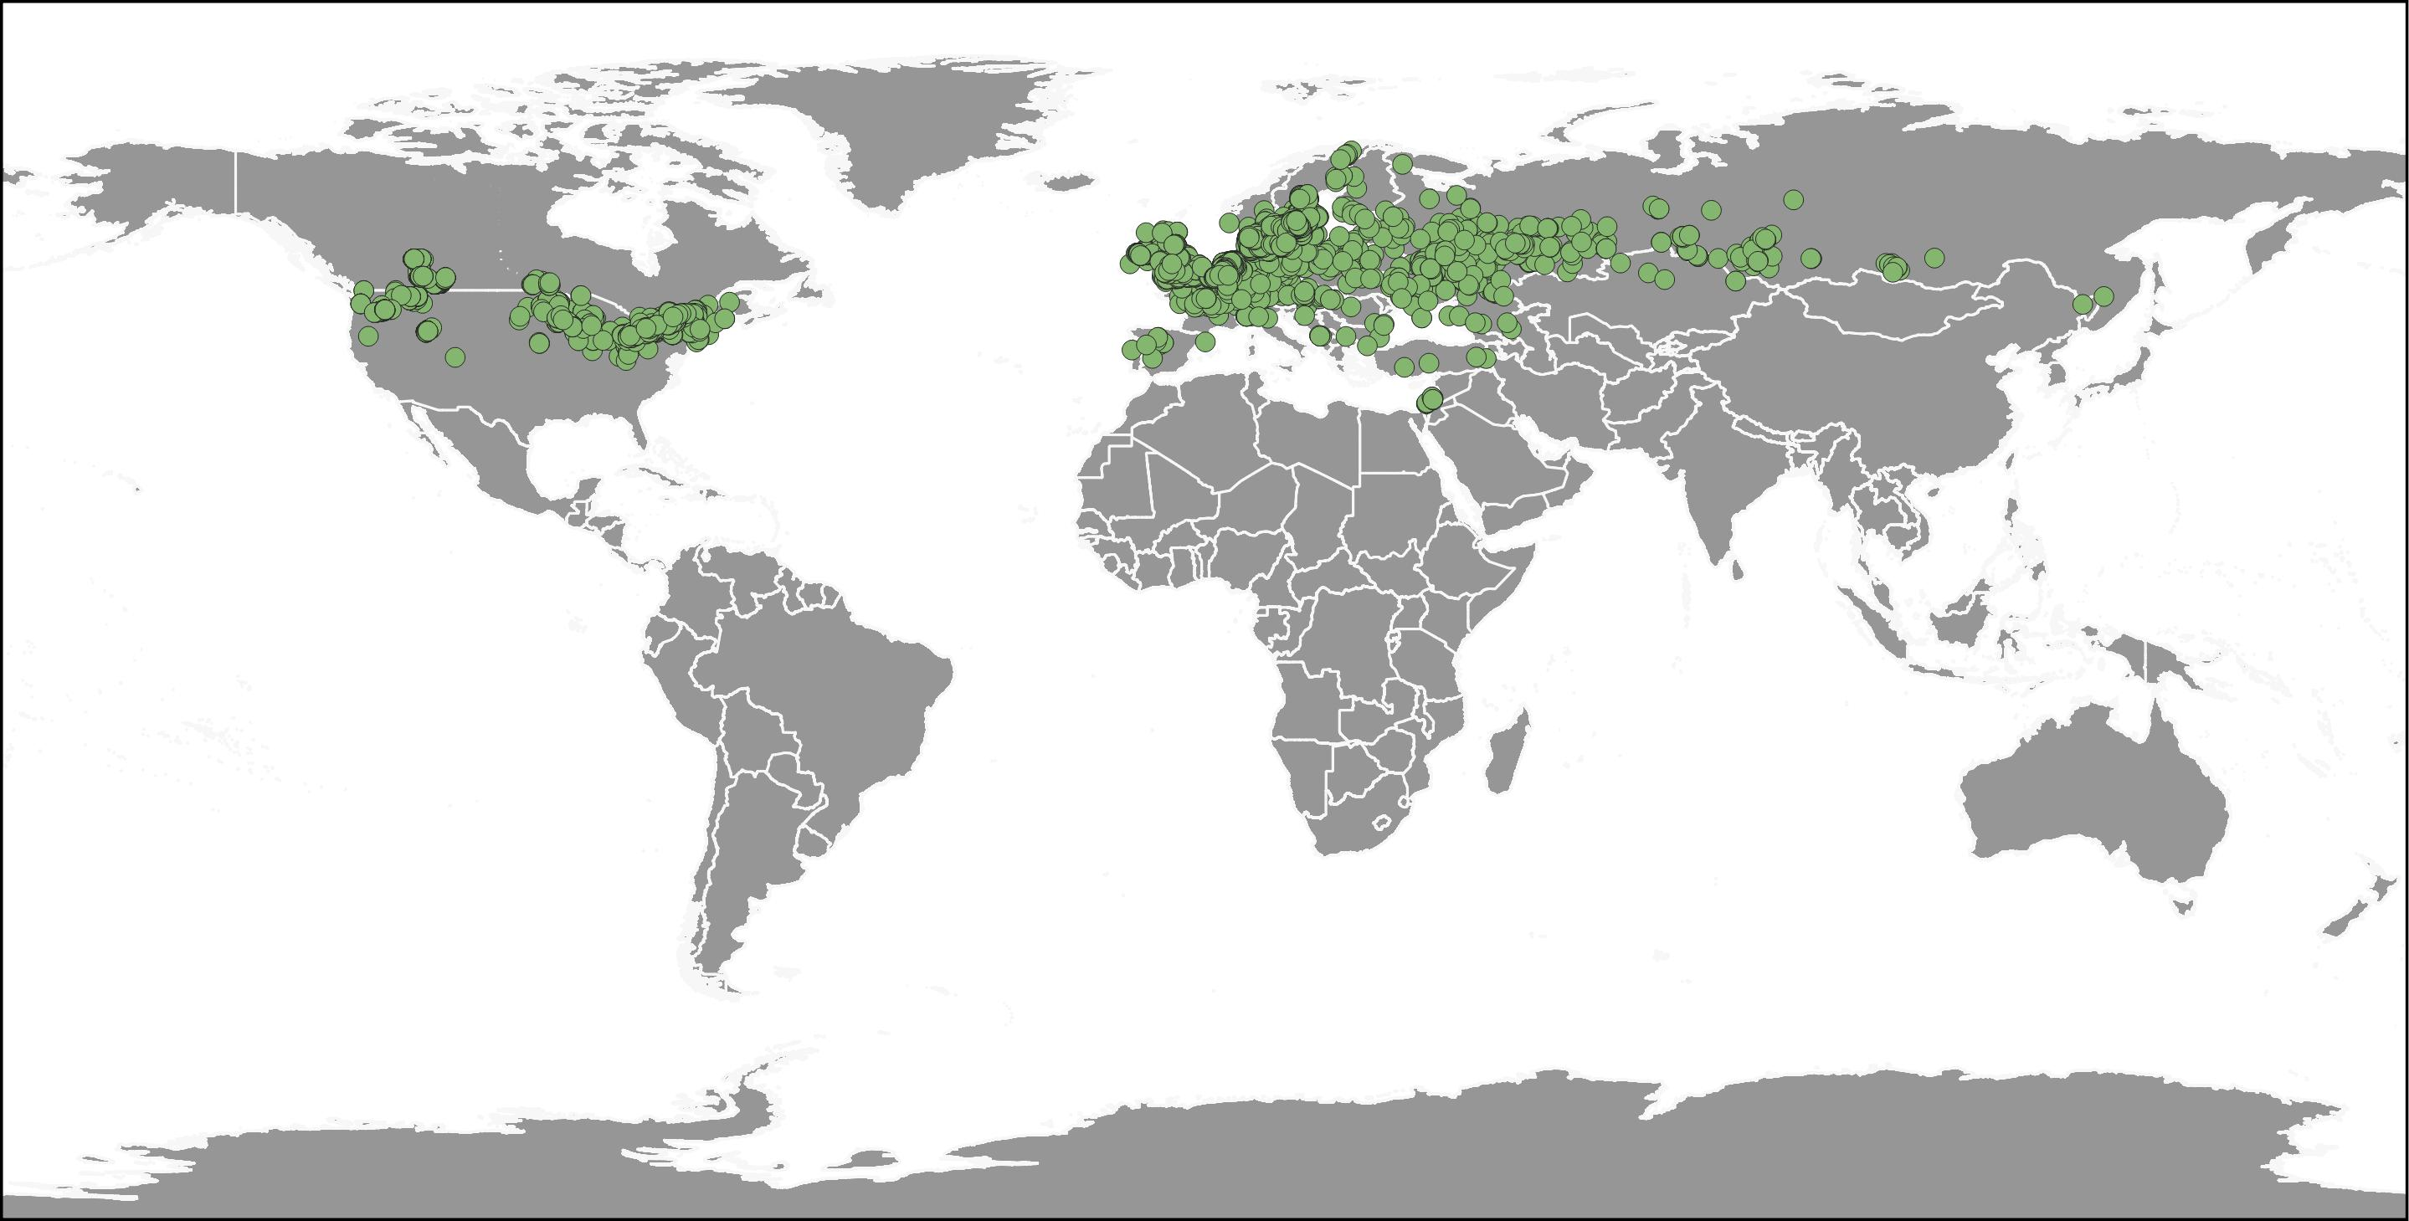
Flowering Rush
a. All occurrences
b. Downscale (0.01DD)
a. n = 19, 136
b. n = 8818
c. n = 7903
c. Final Clean

Slide 4
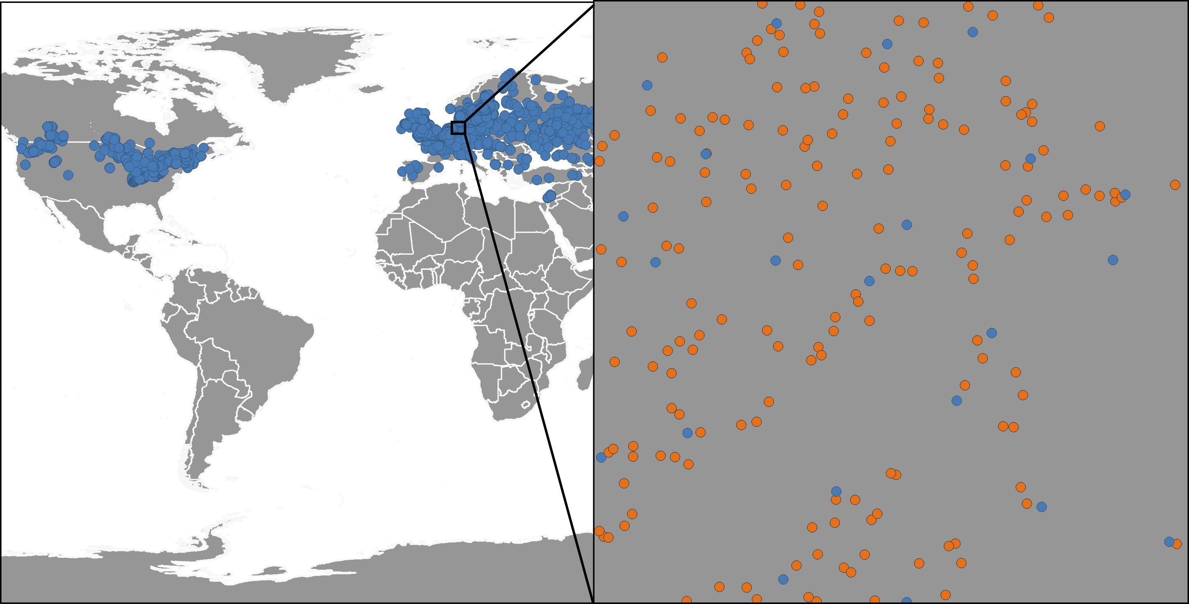
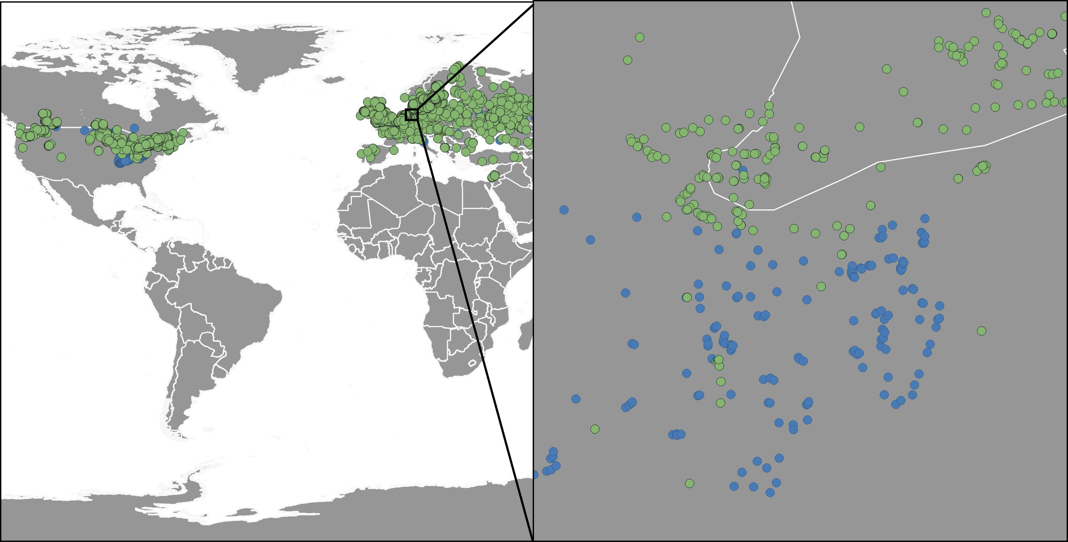
Flowering Rush
a. Downscale Comparison
b. Buffer & Clean Comparison

Slide 5
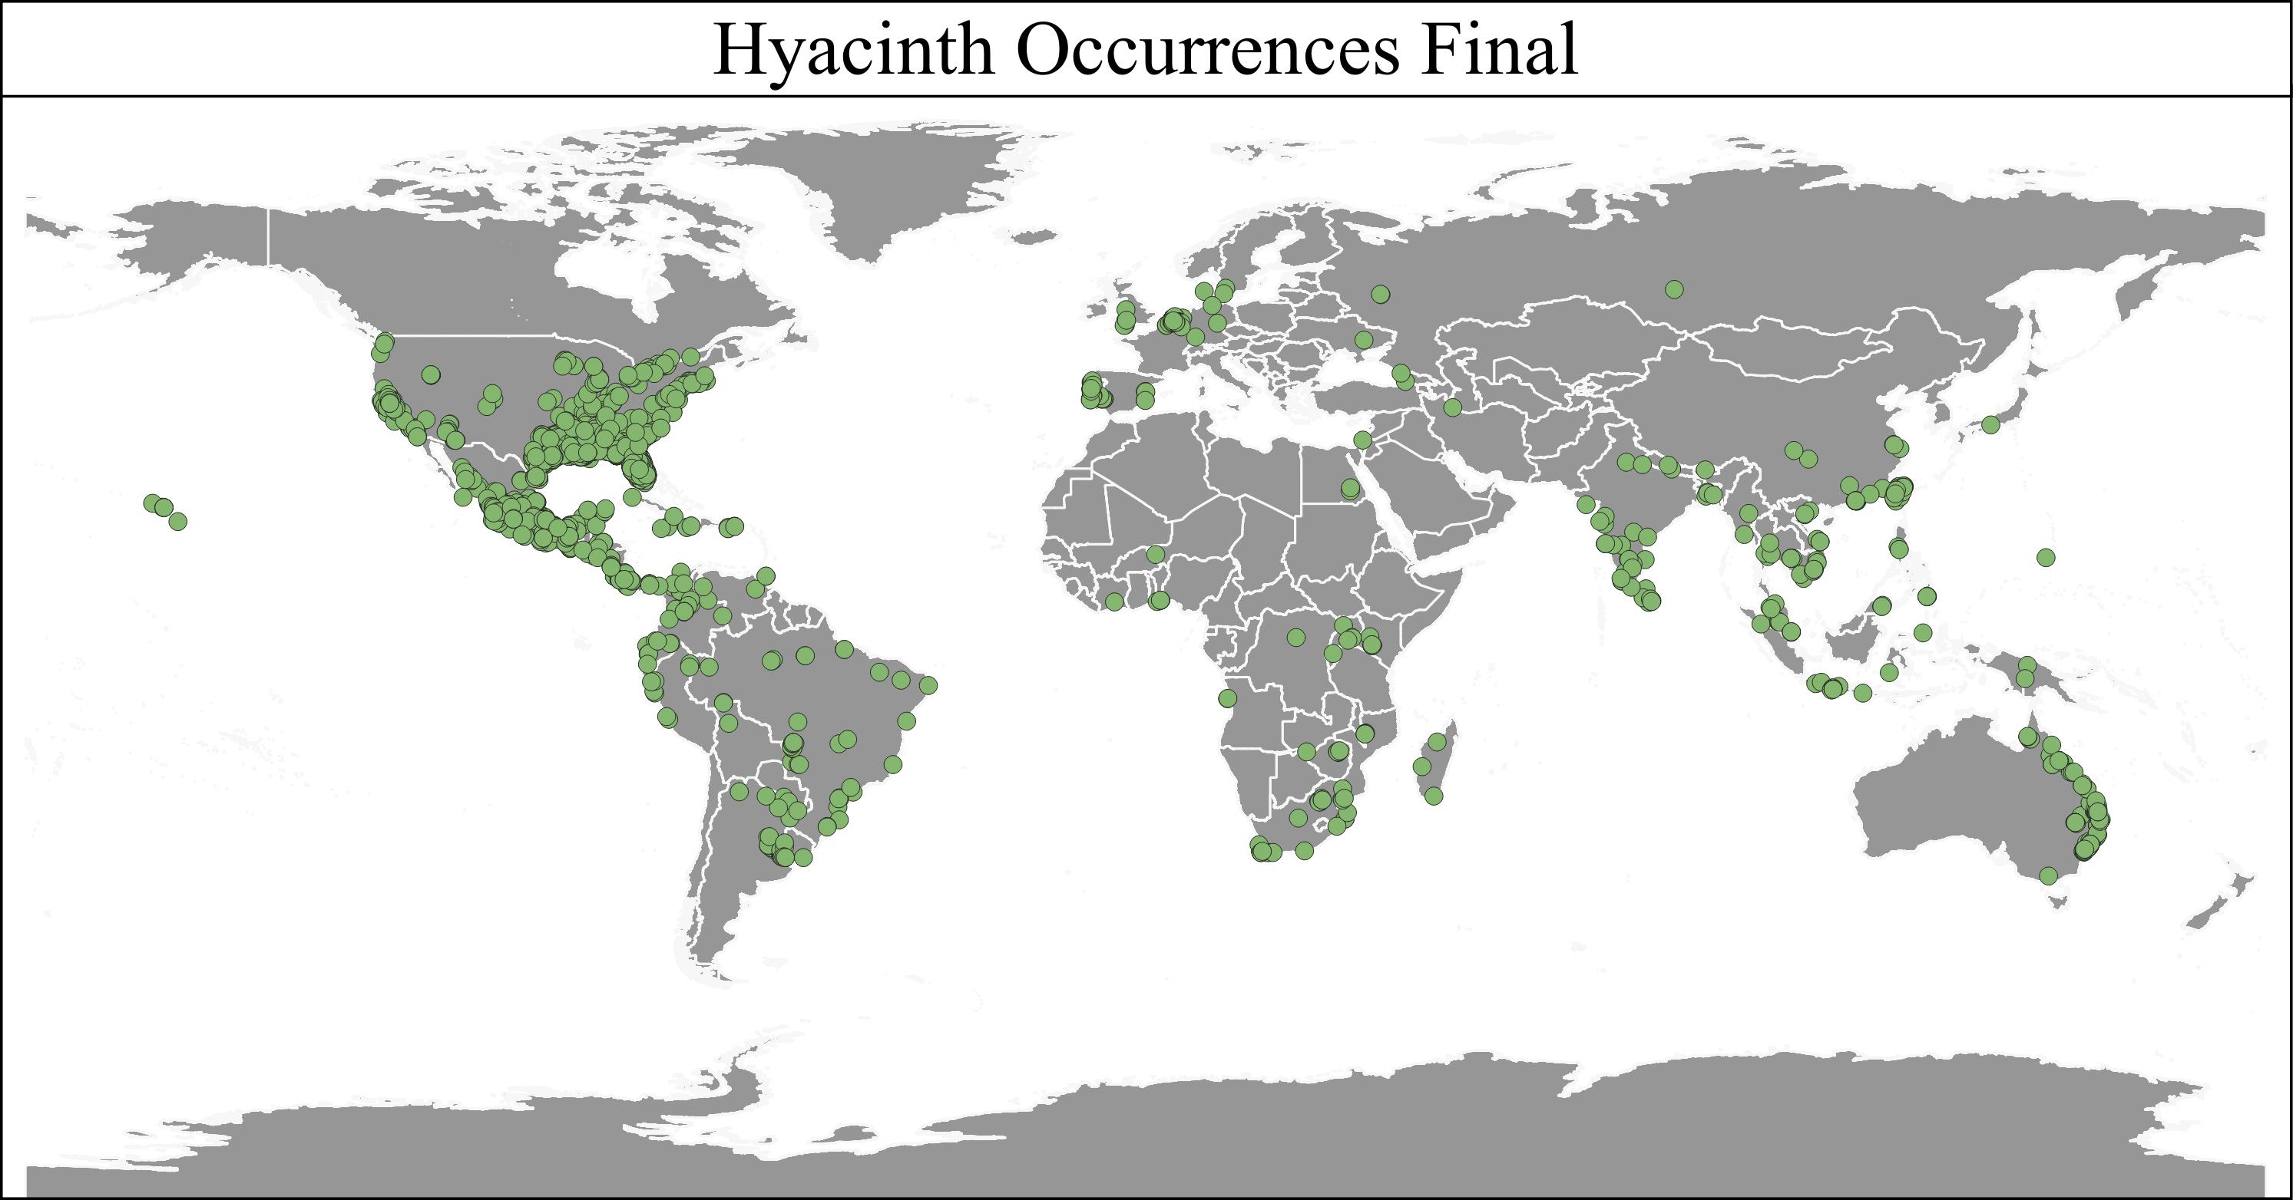

Slide 6
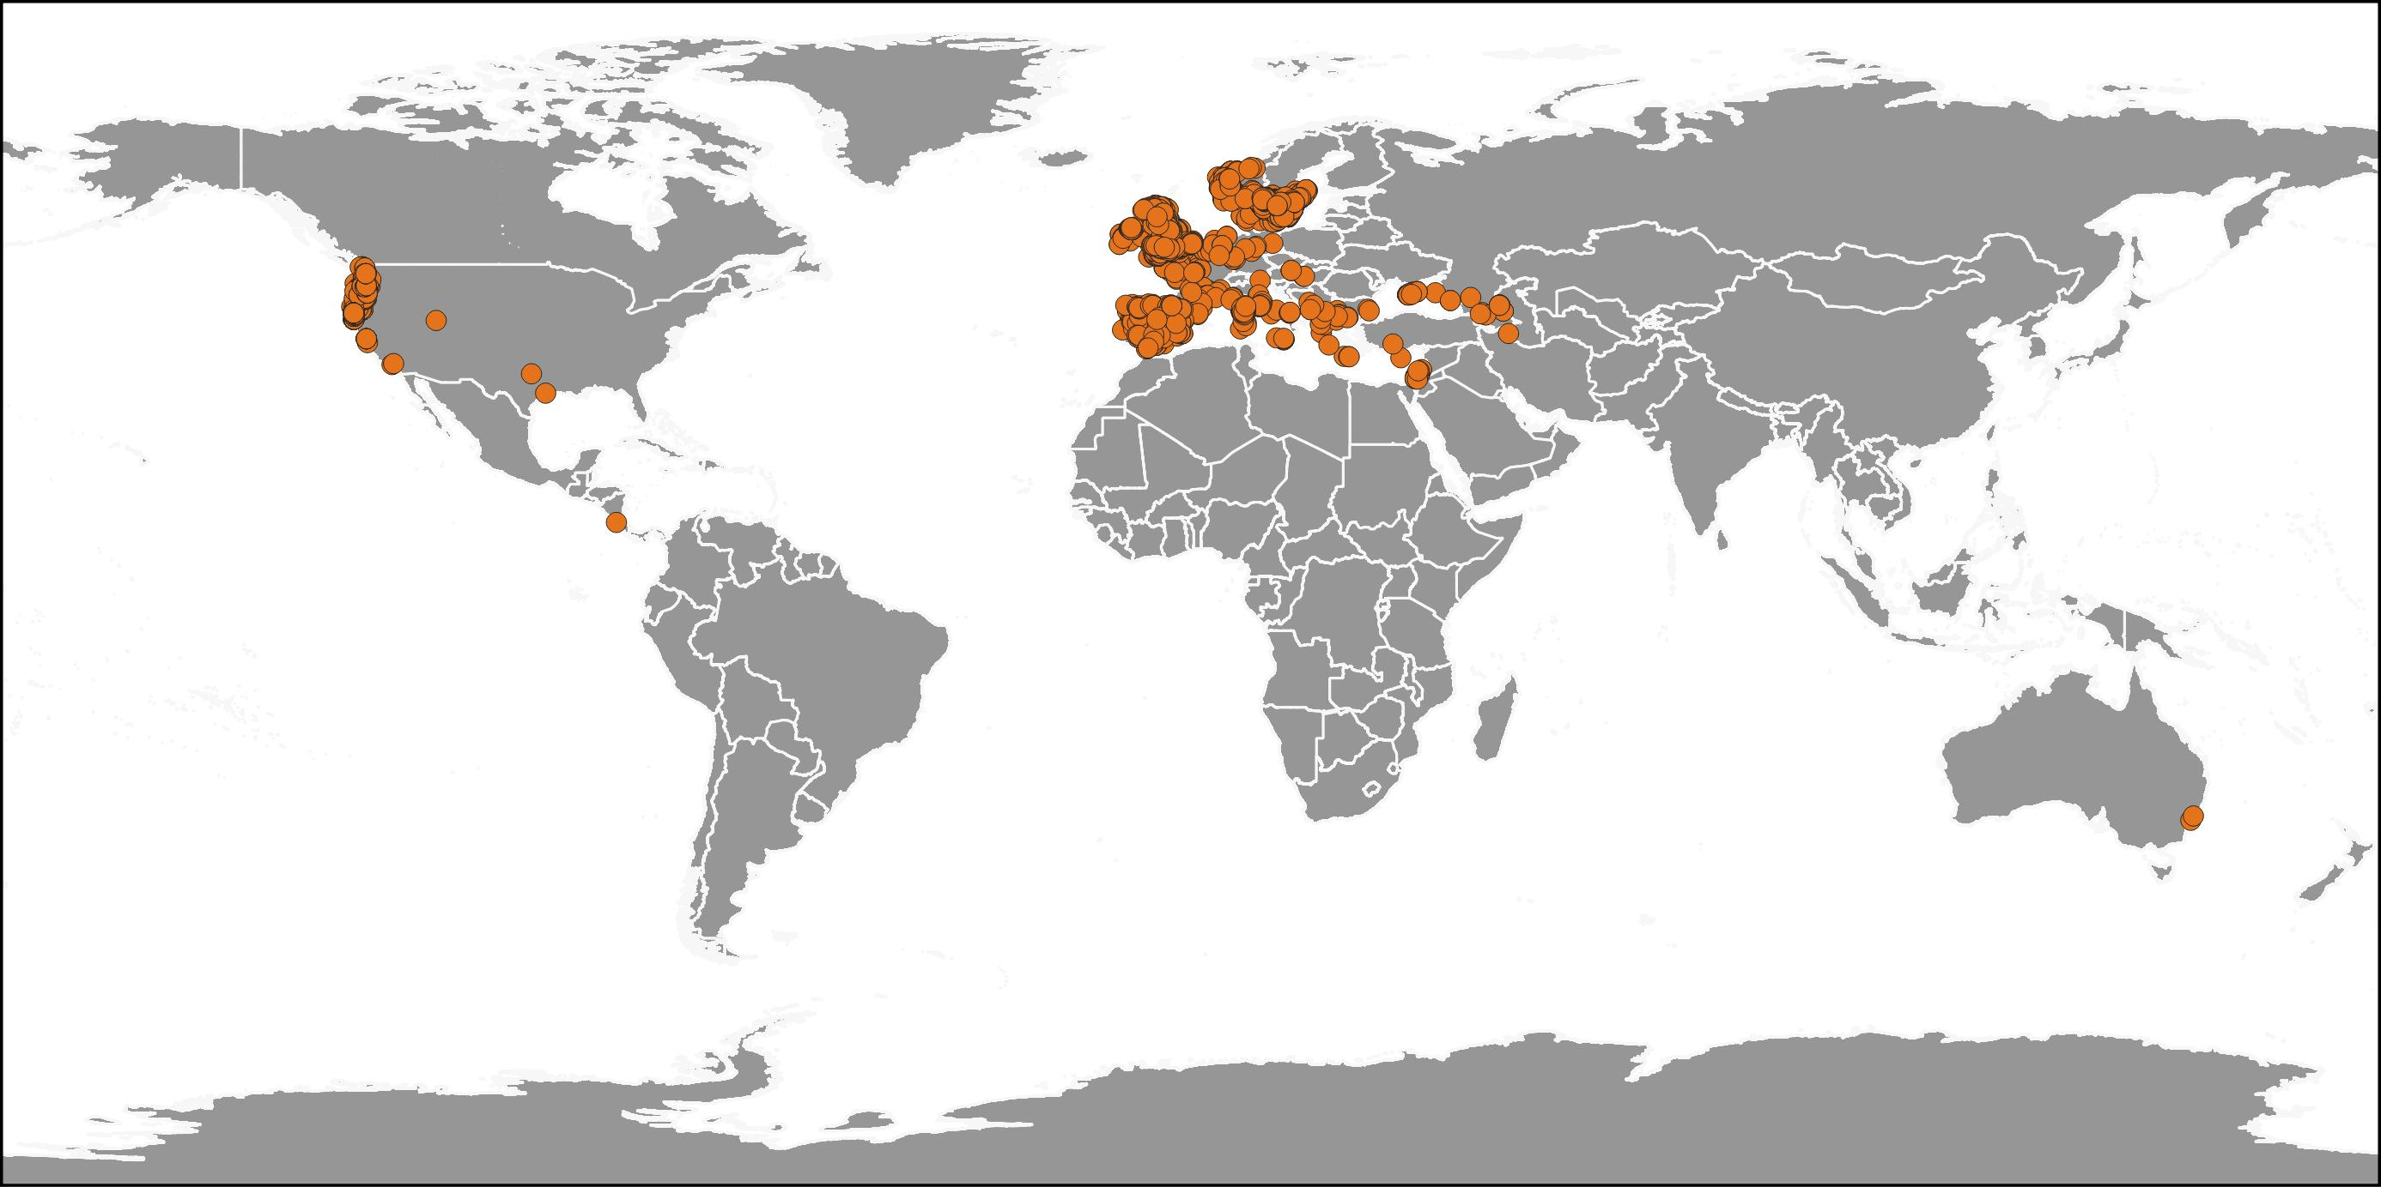
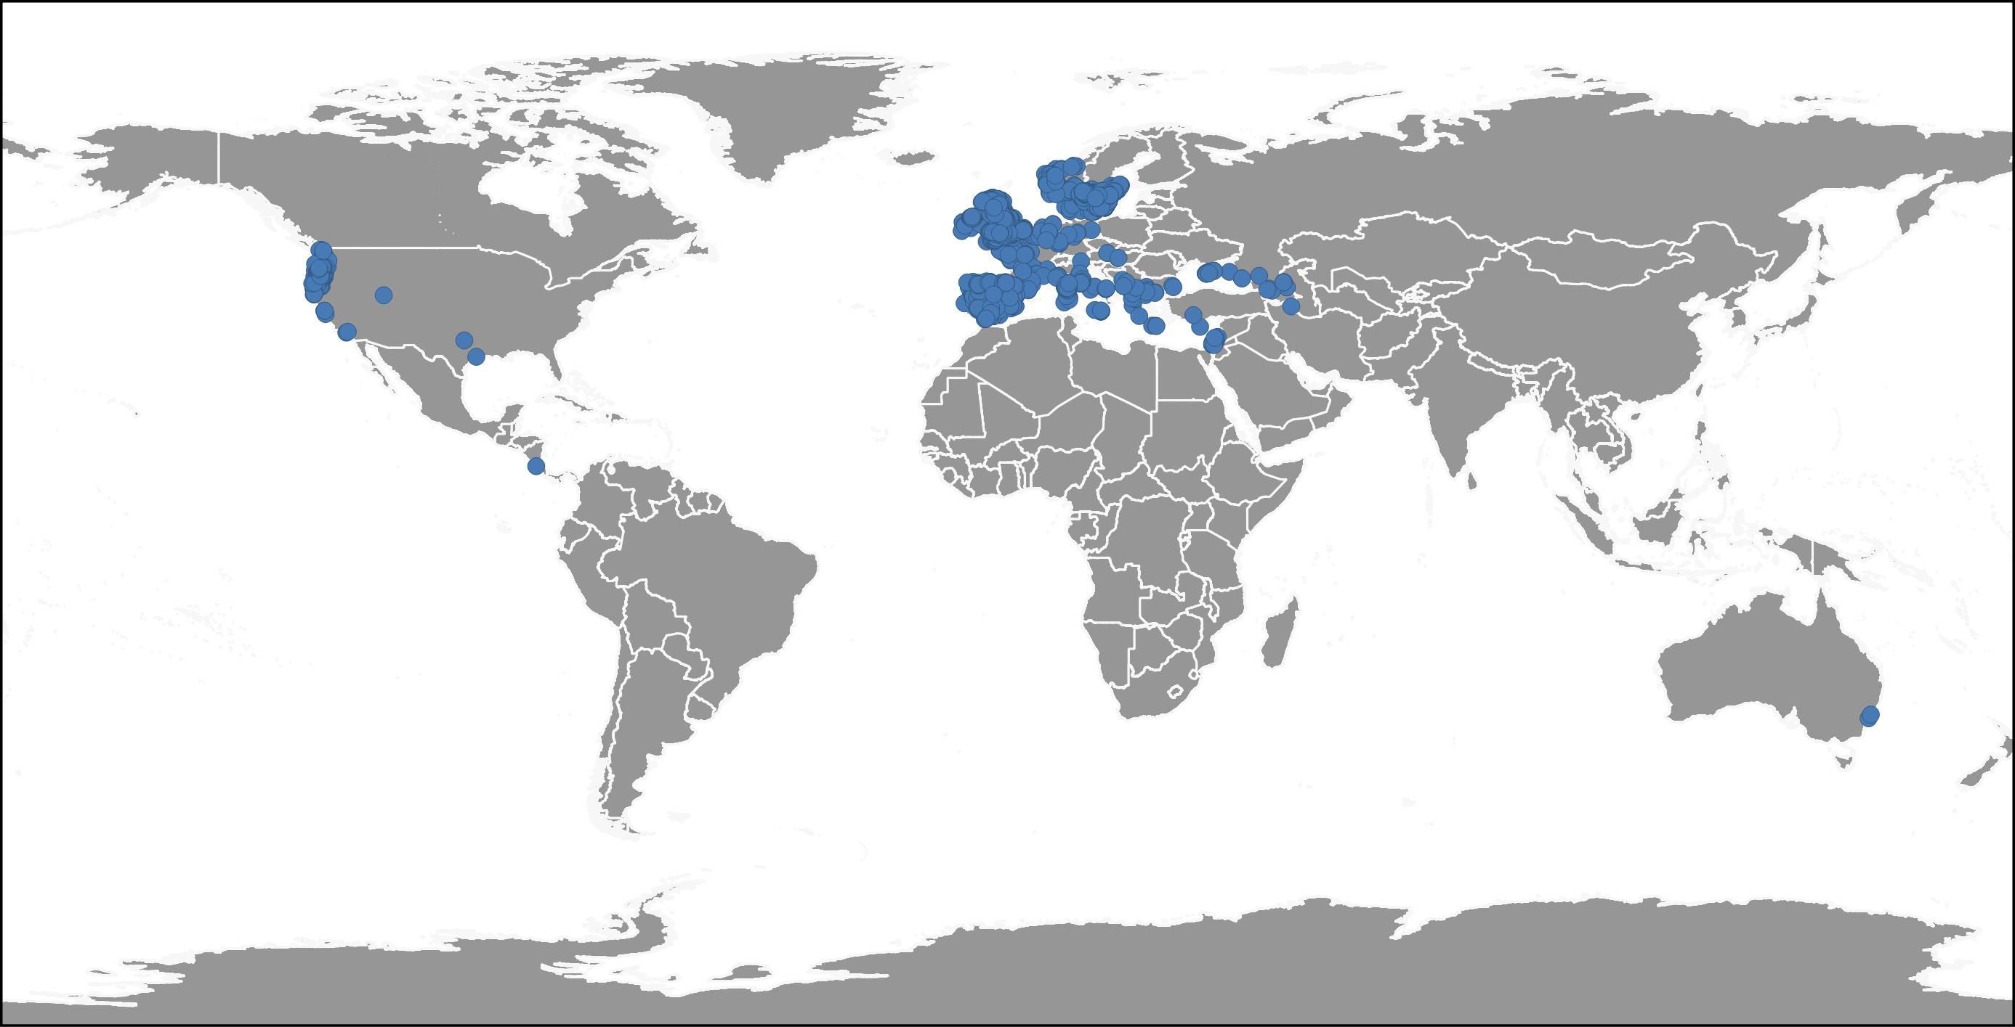
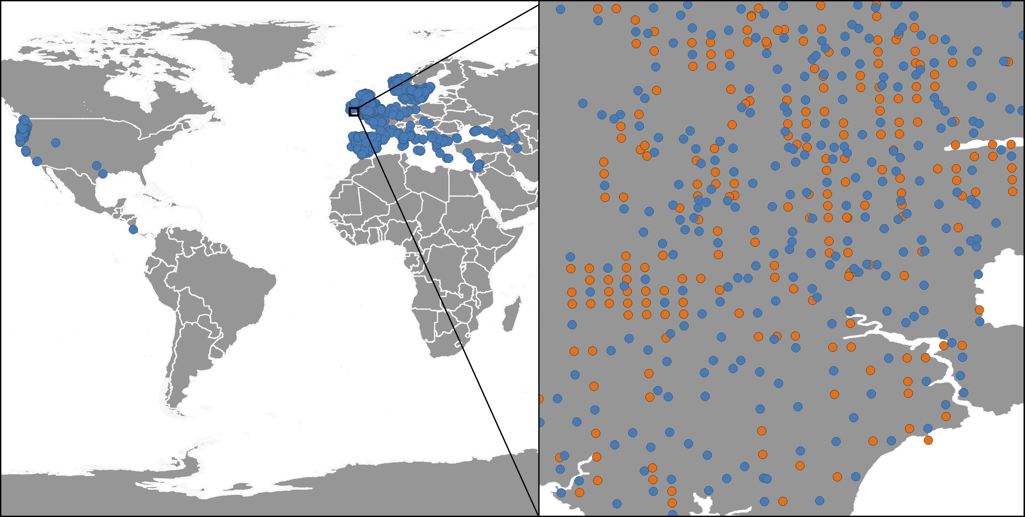
Shiny Geranium
a. All occurrences
b. Downscale (0.01DD)
a. n = 7400
b. n = 4631
c. Comparison

